Slide 1
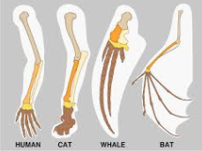
Evidence for Evolution: Comparative Anatomy Geographical Distribution
Comparative Studies in Anatomy
Embryology
Homologous Structures
Vestigial Structures
Geographical Distribution

Slide 2
Date: | Human Biology Year 12 ATAR
Do Now Past Exam Question Lesson Agenda 1: Do Now 2: Other evidence for evolution – Comparative Anatomy, Geographical Distribution 3: Lesson summary and windup Suggested Study Read through today’s notes and textbook section Complete review worksheet, then mark and correct using the answer key on Connect (compulsory). NEXT LESSON Fri lesson: NAIDOC Assembly Mon: Primate Classification and Evolutionary Trends | Learning Aims Define “Comparative Anatomy” and list the three areas considered in studying comparative anatomy. Define “Comparative Embryology” and describe how it provides evidence for evolution. Define “Homologous Structures” and describe how it provides evidence for evolution. Give examples of homologous structures Define “Vestigial Organs” and explain how they provide evidence of common ancestry. Give examples to show how geographical distribution of similar species can provide evidence of common ancestry.
 | Key Vocabulary Embryology Homologous Vestigial

Slide 3
Comparative Anatomy - Intro
Compares structural features of organisms, looking at degree of similarity and therefore relatedness.
3 areas looked at:
Embryology: comparing early embryonic development
Homologous organs: organs that are similar in structure but may be used/adapted for different conditions
Vestigial organs: organs that may once have been important by have lost function
Learning Aim: Define comparative anatomy and list three areas considered in studying it.

Slide 4
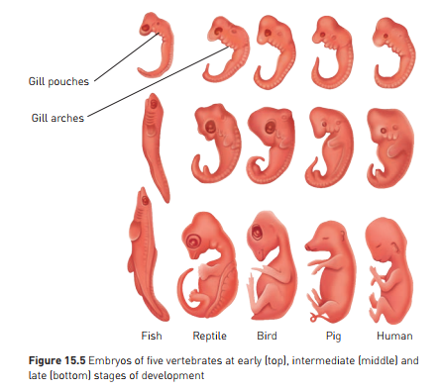
Comparative Embryology
Compares early development to provide evidence for common ancestry and evolutionary change over time
Embryos are initially very similar between species.
Differentiation occurs during development
Mirrors differentiation during evolutionary development
More closely related species are similar for a longer period – evidence of relatedness.
Note on diagram:
All species start with similar features – indicates common ancestry
Gill arches appear in all – why, if mammals don’t need them? Indicates development from an ancestor with gills.
In humans:
One gill slit becomes the Eustachian tube (connects ear to throat)
Tissue from around other gills develops into thyroid and tonsils
Indicates common ancestry then adaptation, reflected in embryonic development.
Learning Aim: Define comparative embryology and describe how it provides evidence for evolution.

Slide 5
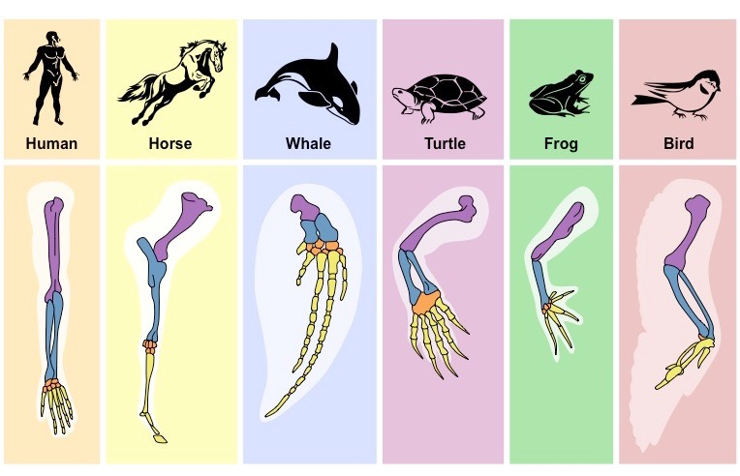
Homologous Structures
Structures that are the same across species but adapted for different functions
Same bones appear in a variety of different species, but are used for different functions.
Evidence of common ancestry, then adaptation.
Learning Aim: Define homologous structures and describe how they provide evidence for evolution.

Slide 6
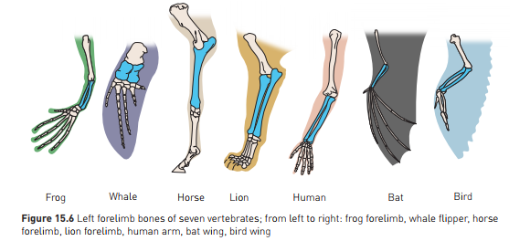
Homologous Structures
Example: vertebrate forelimbs
Same bones appear
Bones arranged in a similar way, but adapted in form to suit function
In pic below: forelimb bones
Learning Aim: Give examples of homologous structures.

Slide 7
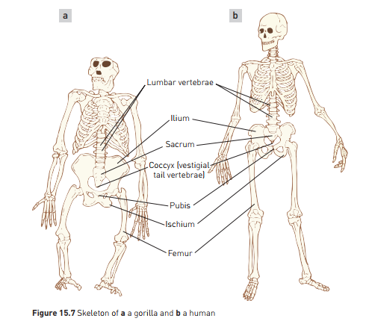
Homologous Structures
Example: Great Apes and Humans
High degree of similarity, even across a range of habitats
Shows that evolutionary divergence is relatively recent
Learning Aim: Give examples of homologous structures.

Slide 8
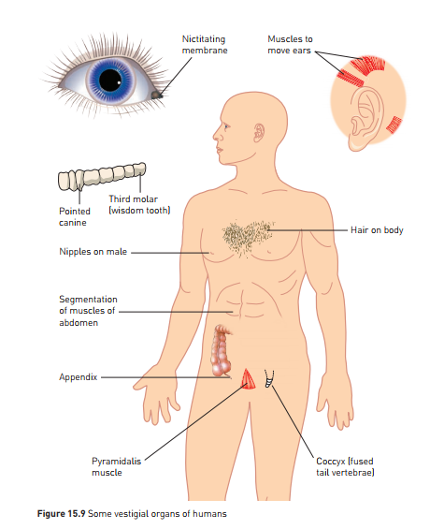
Vestigial Organs
Structures that have no or limited use in the organism, but were of use in an ancestral form. They are usually smaller or almost absent.
Evidence that the organism has evolved from an ancestor but that these organs have ceased to be useful and are no longer selected for – the process isn’t perfect!
Eg:
Snakes sometimes born with vestigial limbs
Humans:
Nictitating membrane at corner of eye – used in cats, not used in humans
Wisdom teeth - some people don’t have them!
Appendix – was caecum in a common ancestor that ate a lot more plant matter.
Learning Aim: Define vestigial organs and explain how they provide evidence for common ancestry.

Slide 9
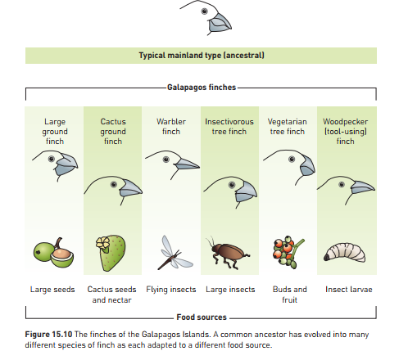
Geographical Distribution – Darwin’s Finches
Further evidence for evolution – can show plausible link between common ancestor and clusters of related species in the same geographical location.
Eg Darwin’s finches – Galapagos Islands
Finches are different in the islands than South American mainland.
Several finches, back in time, travelled from mainland, by chance – blown by a storm??
As a result, no competition, so evolved to take advantage of food sources on offer on different islands
Beaks adapted to different food sources.
Eventually evolved into 13 separate species on the islands.
Evidence of species on island evolving from a common mainland ancestor
Learning Aim: Give examples to show how geographical distribution of similar species can provide evidence of common ancestry.

Slide 10
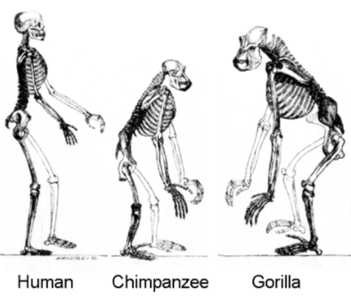
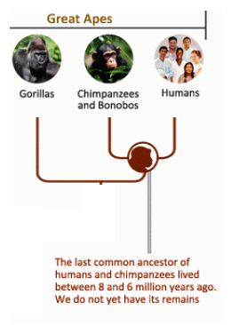
Geographical Distribution: Humans, Primates and evidence
Humans most resemble chimpanzees and gorillas.
Therefore can infer and hypothesise that the common ancestor of Great Apes and Humans most likely lived in place where chimps and gorillas are (Africa) rather than where lemurs or New World Monkeys are.
This has been shown to be true – discovery of ancestral fossils in African Rift Valley.
Learning Aim: Give examples to show how geographical distribution of similar species can provide evidence of common ancestry.

